Slide 1
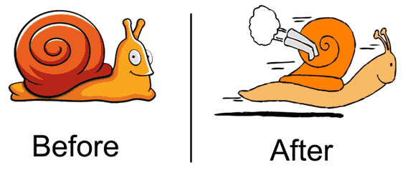
Processor Speedup Strategies
Prof. Ren-Shuo Liu
NTHU EE
Fall 2017

Slide 2
In this Assignment We Will
Know how to generate random numbers
Use the RISCV-Sodor environment
Analyze the execution time of an example program
Apply several optimization strategies
Compiler settings
Assembly coding
Extending the ISA
Pipelining
Loop unrolling
Static reordering / rescheduling

Slide 3
Generating Random Numbers
Pseudo random number generators (PRNG)
Carefully design a function f(x)
Select an initial number (i.e., seed), X₀
A sequence of numbers are available
The numbers seem to be random but in fact they are not
f(x₀)
f(x₁)
f(x₂)
f(x₃)
X₀
X₁
X₂
X₃
…

Slide 4
Generating Random Numbers
Representative PRNG functions
Middle-square method
容易理解，但亂數品質不好，並不常用
Linear congruential generator (LCG)
常被使用於軟體的 rand()
Linear-feedback shift register (LFSR)
常被使用於硬體，這個作業也用到

Slide 5
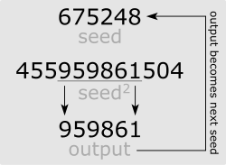
Middle-Square Method
https://en.wikipedia.org/wiki/Middle-square_method

Slide 6

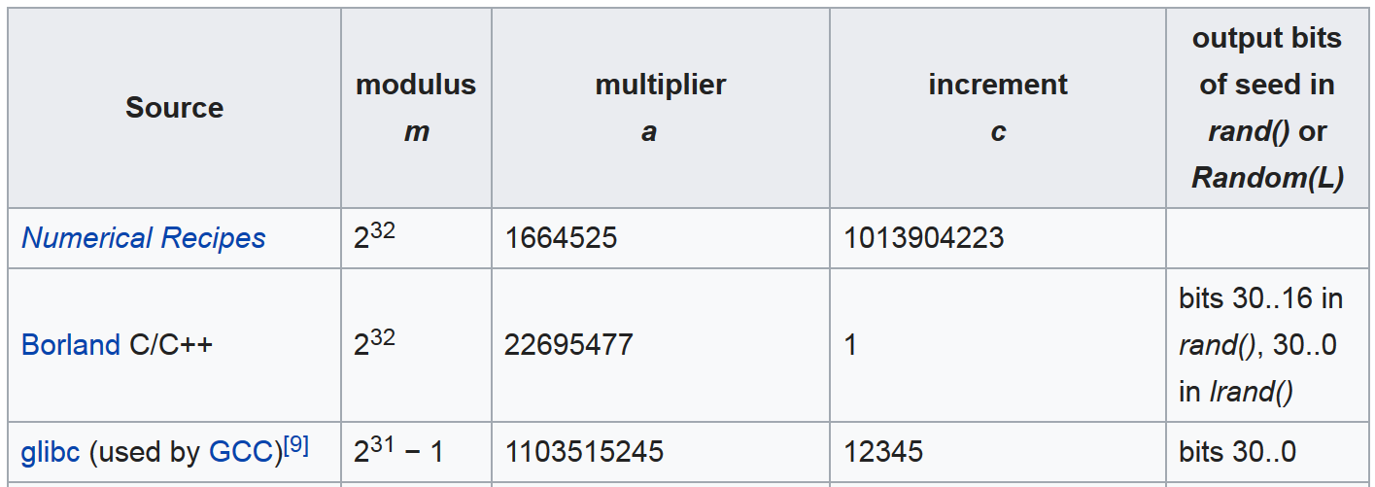
Linear Congruential Generator
https://en.wikipedia.org/wiki/Linear_congruential_generator

Slide 7
Linear-Feedback Shift Register (LFSR)
One example
7
6
5
4
3
2
1
0
+
+
+
+
00000001 (1_{ten}) 🡪 10000000 (128_{ten}) 🡪 11000000 (192_{ten}) 🡪 01100000 (96_{ten}) 🡪 10110000 (176_{ten}) 🡪 11011000 (216_{ten}) 🡪 …. 🡪 00000011 (3_{ten}) 🡪 00000001 (1_{ten})

Slide 8
RISCV-Sodor Environment Overview
Educational processor developed by UC Berkeley
pa4/
|--riscv-tests/
| |--benchmarks/
| |--Makefile
| |--rand_and_search/
| |--main.c
| |--rand_*.S
| |--search_*.S
|--src/
| |--rv32_1stage/
| |--*.scala
| |--rv32_5stage/
| |--*.scala
|--emulator/
| |--rv32_1stage
| |--rv32_5stage
Program we want to analyze and optimize
Baseline c code
Assembly codes
We have prebuilt the 1-stage and 5-stage emulators, so you don’t need to modify these files.
Processor hardware design
Processor simulators

Slide 9
RISCV-Sodor Environment Overview
By using RISCV-Sodor, we can know the performance of a program running on different architectures
Server
*.c, *.S
riscv-gcc
RISCV executable
Inst. count = xxx
Inst. count = xxx
Sodor 1-stage CPU emulator
Sodor 5-stage CPU emulator

Slide 10
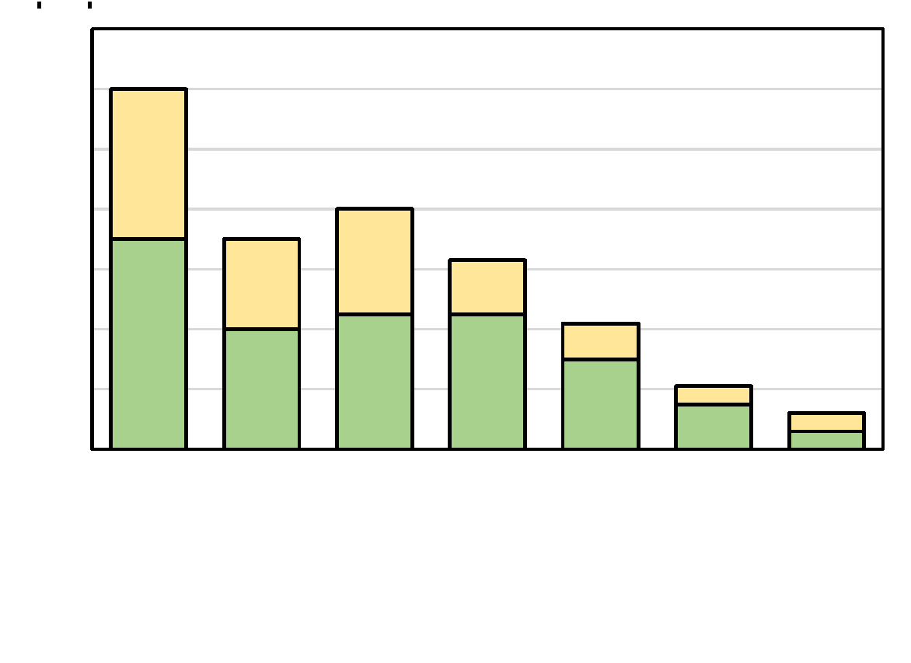
First Step: Understanding the Baseline
Measure the execution time
RAND:
srl …
xor …
srl …
xor …
sw …
addi t0, …
beq t0, … RAND
SEARCH:
lw
beq …
addi t0, …
beq t0, … SEARCH

Slide 11

Set Compiler Optimization Levels
See what speedup compilers can offer

Slide 12
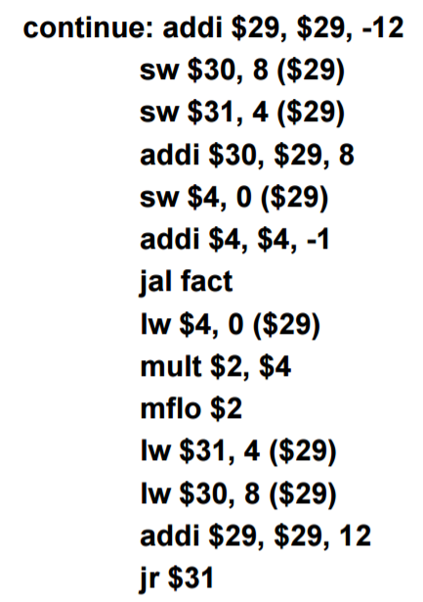
Assembly Coding
Convert the key functions (i.e., rand() and search()) into assembly

Slide 13
Extending ISA
Add a new instruction to directly support LFSR
+
+
+
+
srl …
xor …
srl …
xor …
srl …
xor …
srl …
xor …
lfsr rd, rs1, rs2

Slide 14
Loop Unrolling
LOOP:
lfsr rd, rs1, rs2
sw rd …
addi t0, …
addi a0, …
beq t0, … LOOP
Reduce looping overhead
Overhead = 60%
LOOP:
lfsr rd , rs1, rs2
sw rd …
lfsr rd, rs1, rs2
sw rd …
lfsr rd, rs1, rs2
sw rd …
lfsr rd, rs1, rs2
sw
addi t0, …
addi a0, …
beq t0, … LOOP
Overhead↓

Slide 15
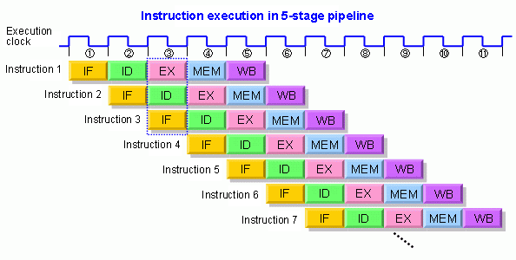
Pipelining
1-stage 🡪 5-stage

Slide 16
Static Instruction Reordering
LOOP:
lw t1
beq t1, a2 …
lw t1
beq t1, a2 …
lw t1
beq t1, a2 …
lw t1
beq t1, a2 …
addi t0, …
addi a0, …
beq t0, … LOOP
hazards 🡪 stall cycles

Slide 17
Static Instruction Reordering
Resolve the hazards in the assembly program
LOOP:
lw t1
lw t2
lw t3
lw t4
beq t1, a2 …
beq t2, a2 …
beq t3, a2 …
beq t4, a2 …
addi t0, …
addi a0, …
beq t0, … LOOP

Slide 18
What You Need to Turn In
Six assembly programs
Answer some questions in homework 4 (NOT in this assignment)
 | rand() |  | search()
V1 | Basic assembly version |  | Basic assembly version
V2 | + lfsr instruction |  | + unroll 4 times
V3 | + unroll 4 times |  | + static reordering

Slide 19
More About the LFSR Instruction
7
6
5
4
3
2
1
0
+
+
+
+
Bit 7, 6, 1, 0 are XORed 🡪 11000011₂ 🡪 0xc3
The XOR result is placed at bit 7
lfsr rd, rs1, rs2
rs2 is set to 380000c3_{hex}
We have implemented this instruction
What you need to do is to enable and use it
5 bits
27 bits
7
0xc3
380000c3

Slide 20
More About Loop Unrolling
Unroll an N-iteration loop for k times
Need to consider the case that N%k != 0
for ( i = 0; i < N%k; i++ ) {
things_to_do(i);
}
for ( ; i < N; i+=k ) {
things_to_do(i);
things_to_do(i+1);
things_to_do(i+2);
...
things_to_do(i+k-1);
}
for ( i = 0; i < N; i++) {
things_to_do(i);
}

